Slide 1
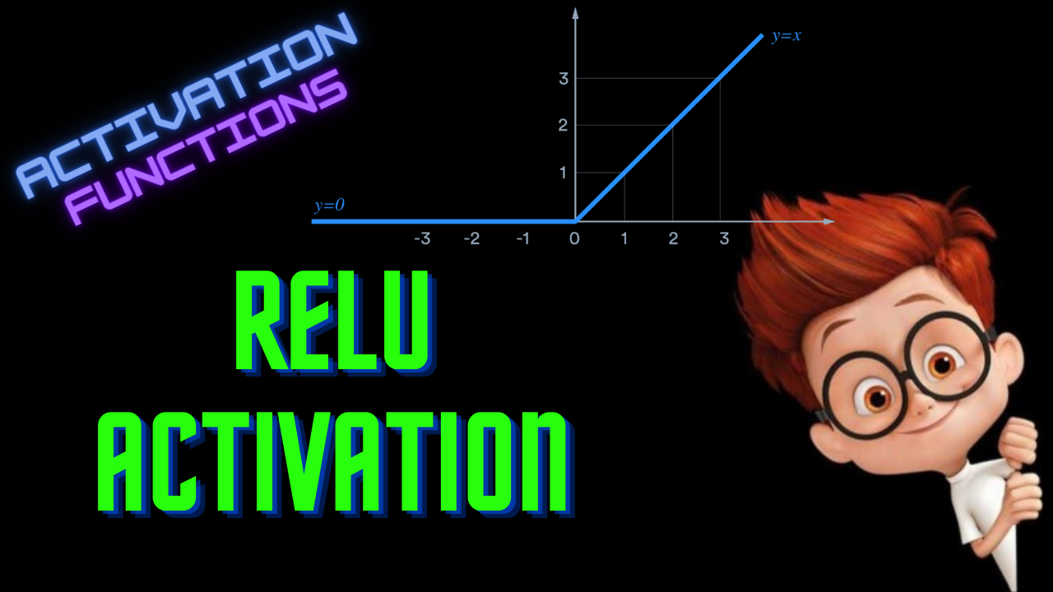

Slide 2
ReLU Activation
ML For Nerds

Slide 3
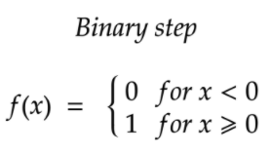
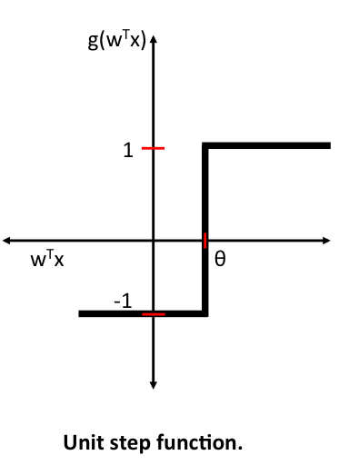

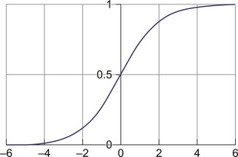

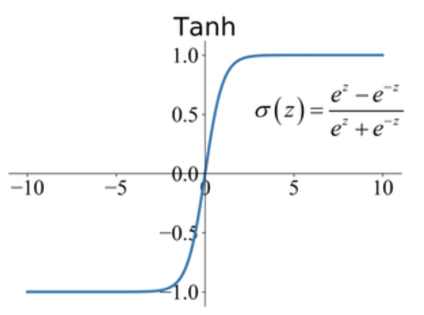
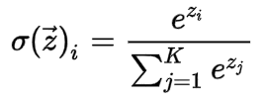
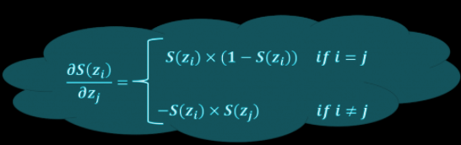
Recap
Step | Y = 0 or 1 | f’(x)=0 |  | *Not used much *Binary
Sigmoid |  | f’(x) = f(x)* (1-f(x)) |  | * Binary * Preferred
Tanh |  | f’(x) = 1- f(x)^2 |  | * Binary * Better than Sigmoid * Hidden layers
Softmax |  |  |  | * Multi-class * Output layers

Slide 4
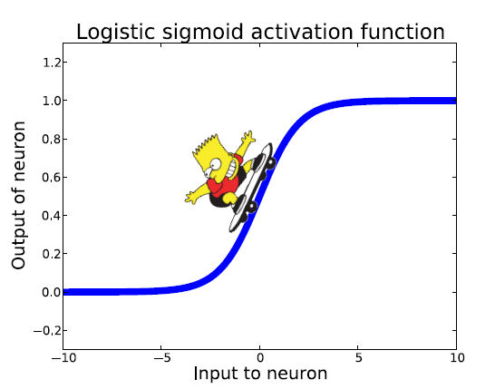
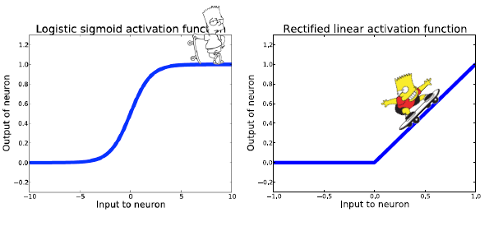
Vanishing Gradient

Slide 5
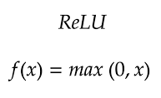
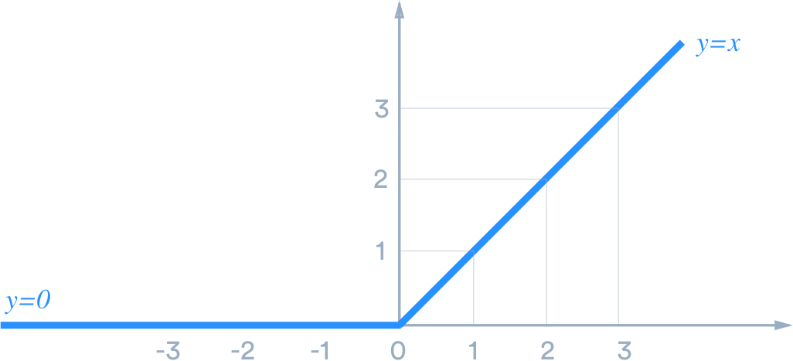
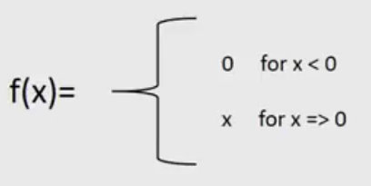
ReLU

Slide 6
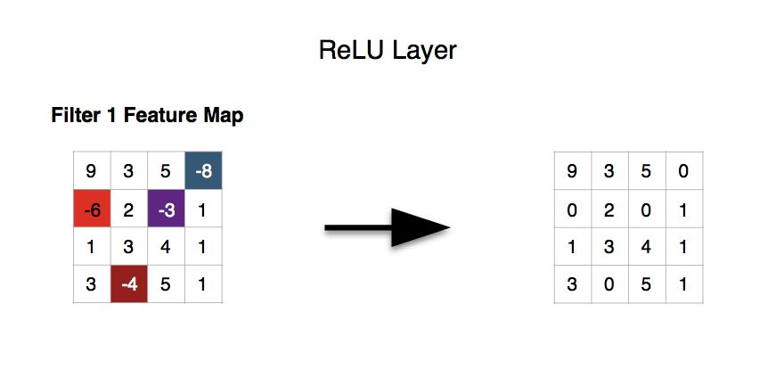

Slide 7
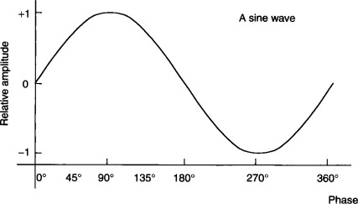
Fit the Sine wave

Slide 8
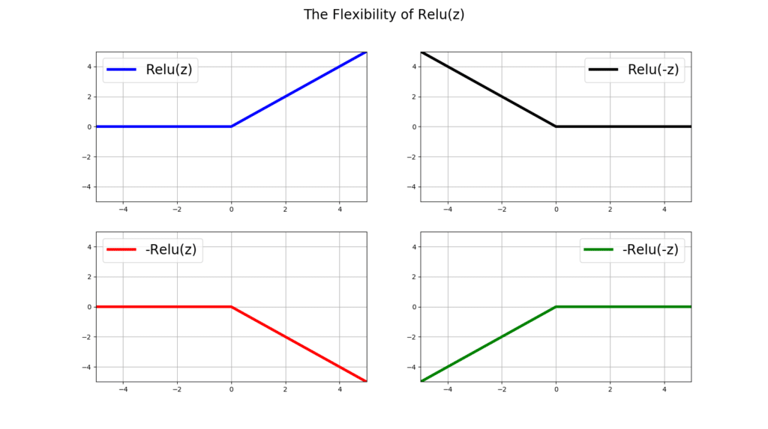
ReLU function variations - Negative inputs

Slide 9
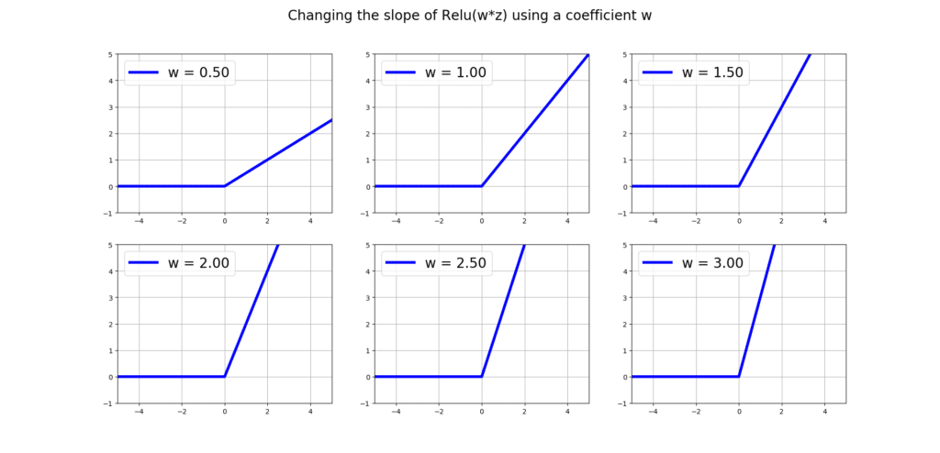
Changing Slope

Slide 10
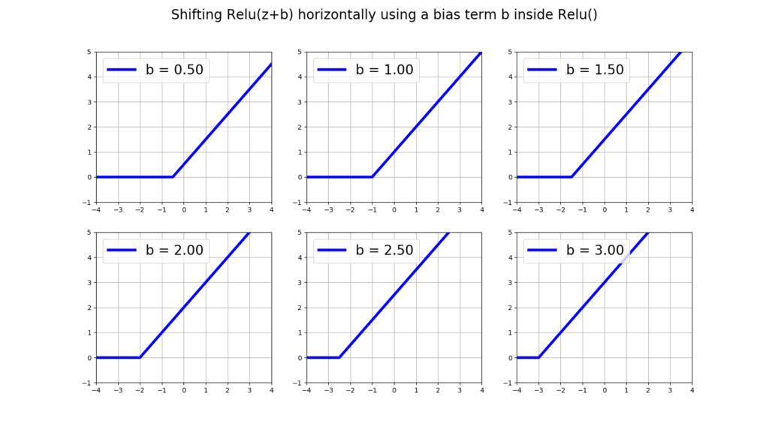
Changing Bias - Horizontal

Slide 11
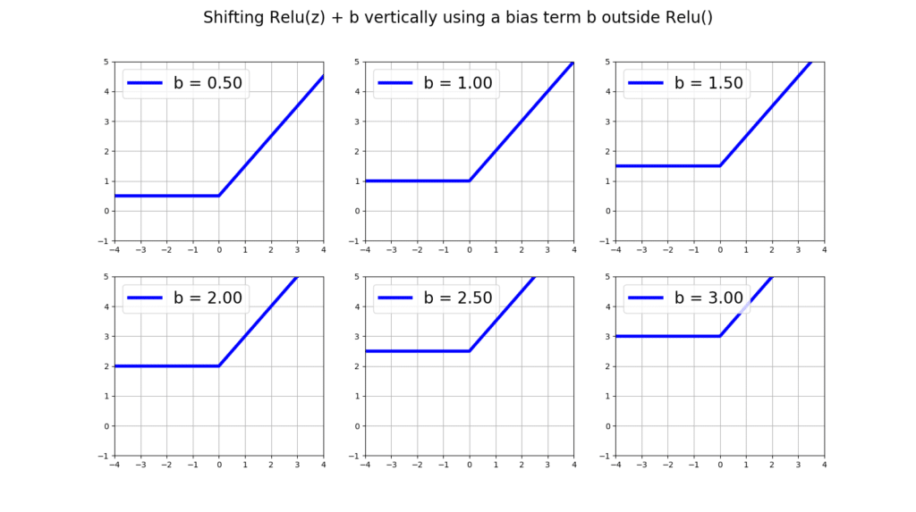
Changing Bias - Vertical

Slide 12
ReLU in Action

Slide 13
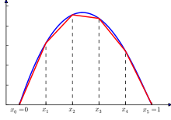
Sine Approximation

Slide 14
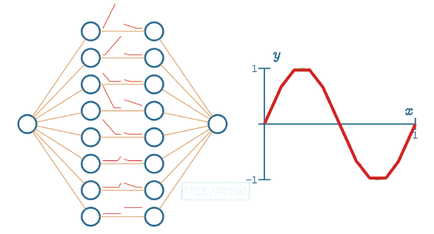
Sine wave Approximation
Arch - (1,8,8,1)

Slide 15
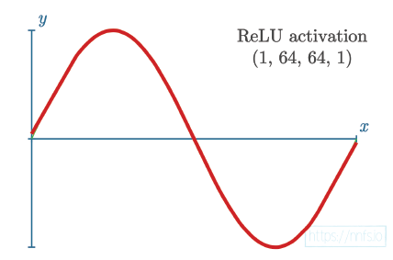
Sine wave Approximation
Arch - (1,64,64,1)

Slide 16
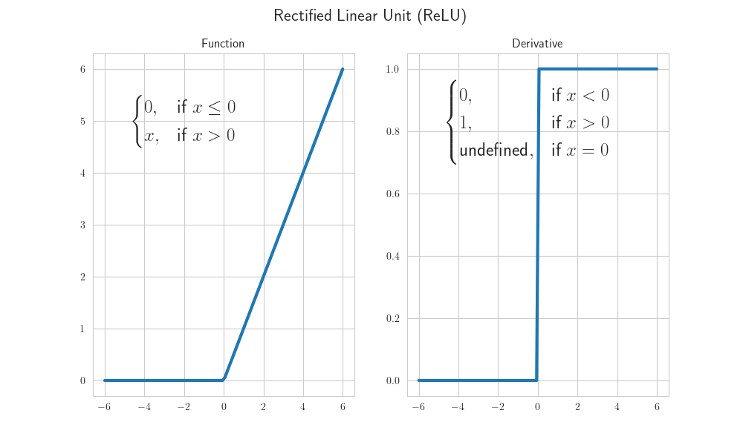
Derivative
f’(x) = 0 for x=0

Slide 18
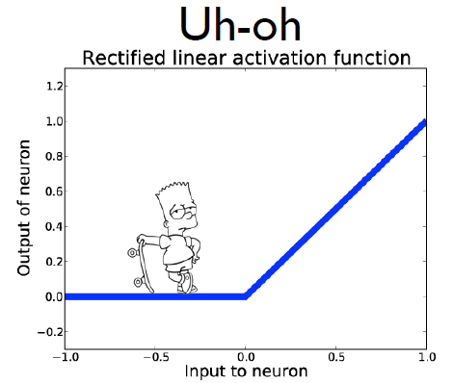
Dead Neurons
Y = ReLU(W*X + b)

Slide 19
Advantages
Computationally Simple
Representational Sparsity
Linear Behaviour
Train deeper networks

Slide 20
Advantages
Computationally Simple
Representational Sparsity
Linear Behaviour
Train deeper networks

Slide 21
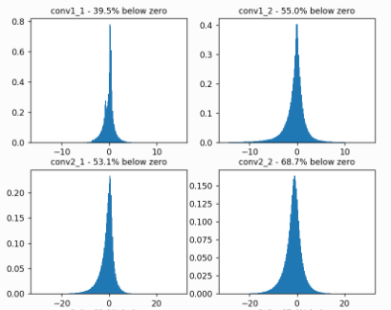
Negative inputs to Activation

Slide 22
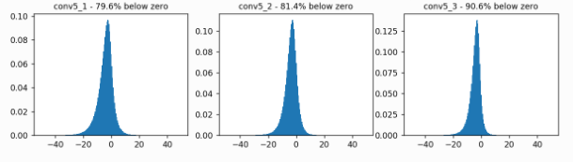
Negative inputs to Activation

Slide 23
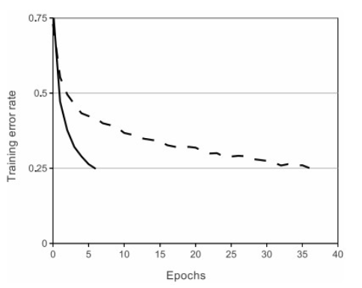
Advantages
6x Faster than Tanh
Computationally Simple
Representational Sparsity
Linear Behaviour
Train deeper networks

Slide 24
Advantages
Computationally Simple
Representational Sparsity
Linear Behaviour
Train deeper networks

Slide 25
Drawbacks
Exploding Gradient
Dead Neurons
Learning rate

Slide 26
Drawbacks
Exploding Gradient
Dead Neurons

Slide 27
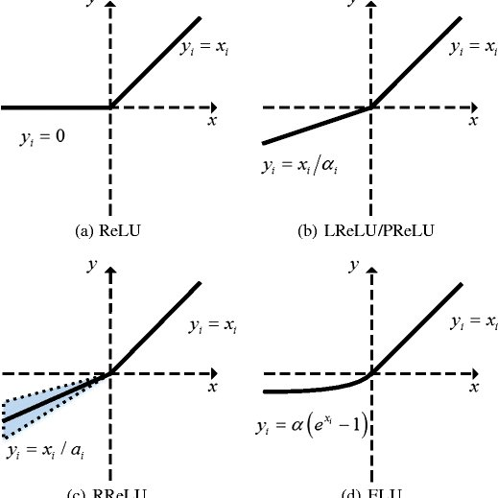
Drawbacks
Exploding Gradient
Dead Neurons

Slide 28
Tips
Default Activation
Smaller bias values
He Weight Initialization
Scale input data
Weight penalty

Slide 29
Python Implementation
def relu(x):
return max(0,x)
Derivative:
if x>0:
return 1
else:
return 0

